Slide 1

CARD CREATION LIFE CYCLE (ACCOUNT BOARDING,EMBOSSING,CARD TRANSACTIONS)
10-June-2019
Prepared by,
Brindha Devi
Rakesh
Salma Sulthana

Slide 2

ACCOUNT BOARDING
KYC
- AML
- Customer/Card Account Creation
KYC(Know Your Customer):-
- It is a process by which banks obtain information about the identity and address of the customers.
- It helps to ensure that banks services are not misused
- KYC procedure is to be completed by the banks while opening accounts and also periodically update the same.

Slide 3
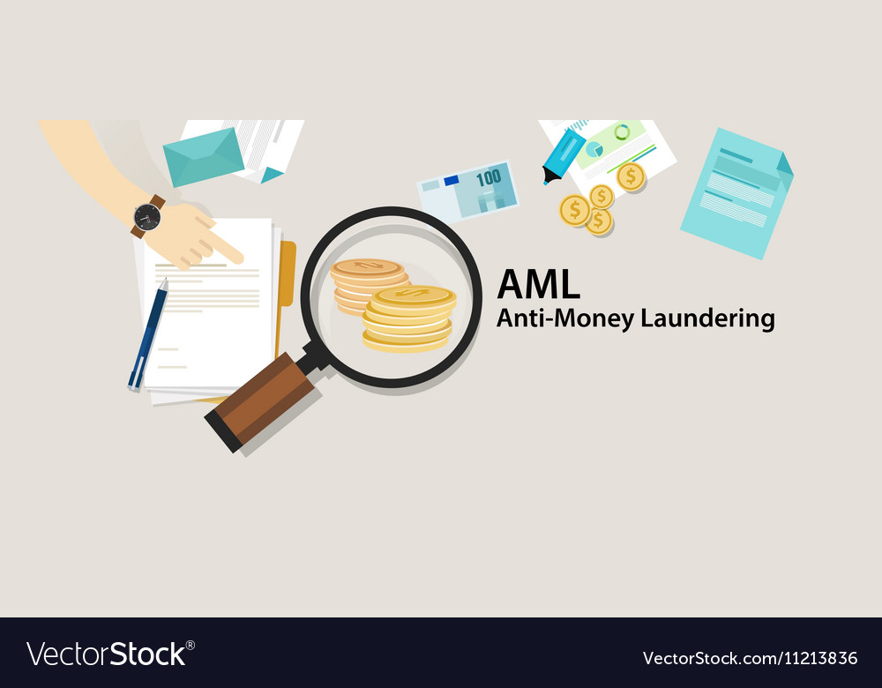
AML-Anti Money Laundering
AML is the Regulatory field of which KYC is a part.
It targets Criminal activities including trading in illegal Goods,corruption of Public funds,fraud,Robbery.
Its purpose is to stop the generation of financial income through illegal means.
After verification of the customer is completed.The bank may Approve/Decline the customer for card account creation

Slide 4
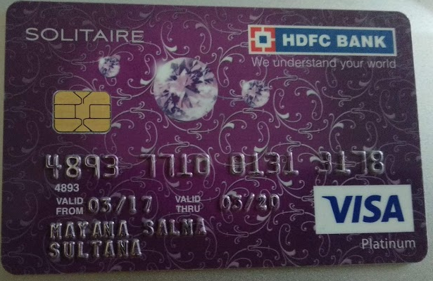
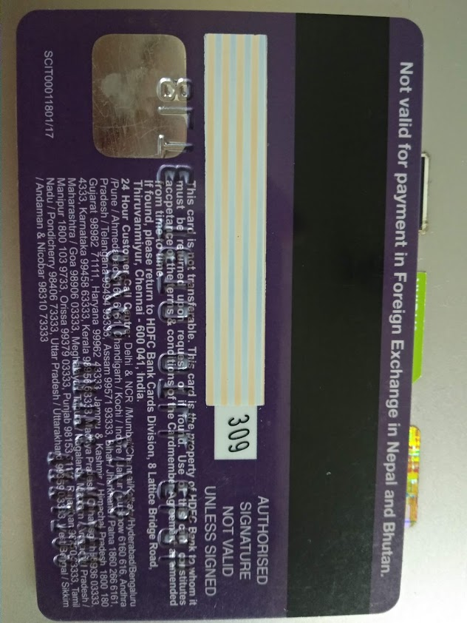
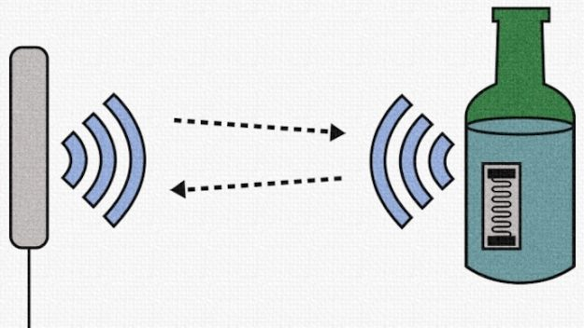
Embossing Once account boarding is done the next step is embossing of credit card such as Printing the details on card like card holder name, card number and card valid date & expiry date on the card. Features like Bank branding,EMV(Europay,Master card,Visa) chip,Network type,Magnetic stripe,Hologram,Bank contact information,signature area,CVV (Card Verfication Value),Bank logo,RFID (Radio-Frequency Identification) icon,card category(like -silver,gold,solitaire,platinum & premium).
RFID (for tapping)
Bank logo
Bank brand
Card category
Magnetic stripe
EMV chip
Signatory Area
CVV number
Card number
Hologram
Valid date
Card network type
Card holder name
Card expiray date
Bank contact information

Slide 5
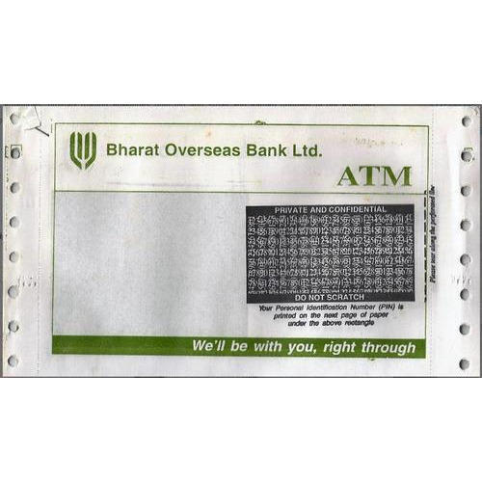
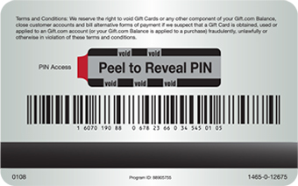
SDP(Same Day Processing) Cards SDP cards activation process will be in single day(within 24 hours) and it is provided to HNI(High Networth Individuals) customers.Otherwise activation process will take within a week. Card & PIN mailer Card & hiding the PIN number with scratch off or peel-back panels that highlights any attempts at tampering.Generally sent to card holders address using postal service.
Scratch Off
Peel back panel

Slide 6
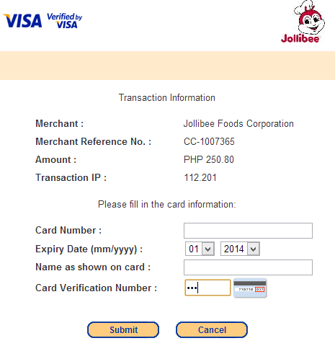
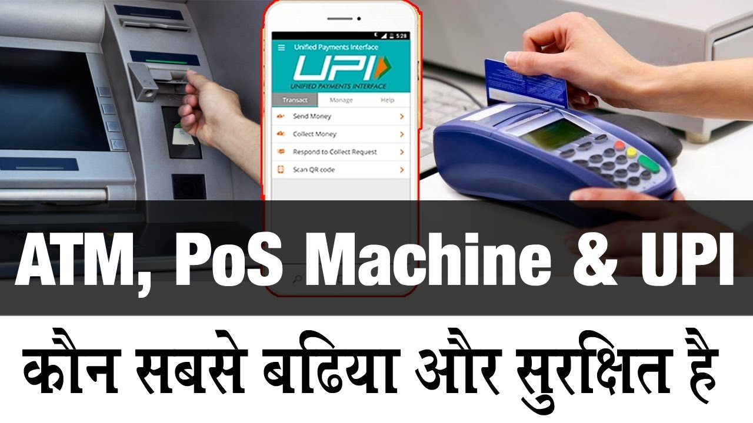
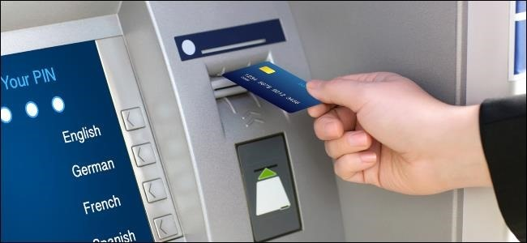
CARD TRANSACTIONS
MERCHANT TRANSACTION
ATM TRANSACTION
ONLINE TRANSACTION

Slide 7
CROSS COUNTRY AND CROSS BORDER TRANSACTION:-
Cross border transaction : Cross border transaction is the transaction between neighbouring countries.For eg.,Transaction between India & Pakistan.
Cross country transaction : Cross country transaction is the transaction between countries except neighbouring countries.For eg.,Transaction between India & US.
Transaction reversal & Fees
The funds a cardholder used in a transaction are returned to the cardholder’s account and some reversal fees applicable according to the customer request.
Rewards
It is the cashback or reward points with customer’s purchase or number of transactions.

Slide 8
THANK YOU

